Slide 1
Object Oriented Programming CS F213 Amit Dua
Slide material from book “Head First Design Patterns”

Slide 2
Observer Pattern

Slide 3
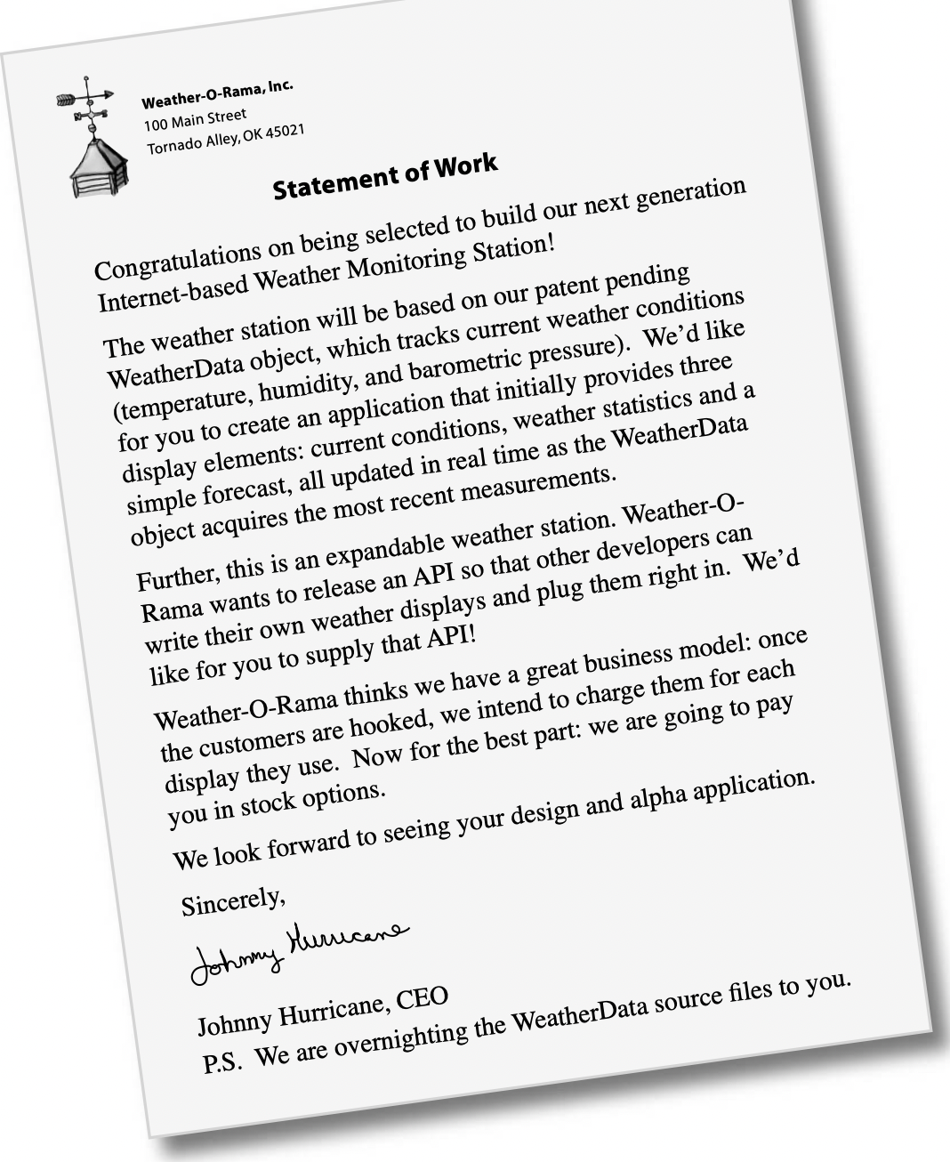

Slide 4
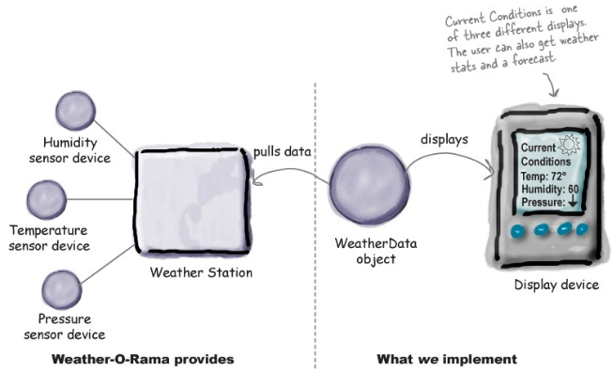
Problem

Slide 5
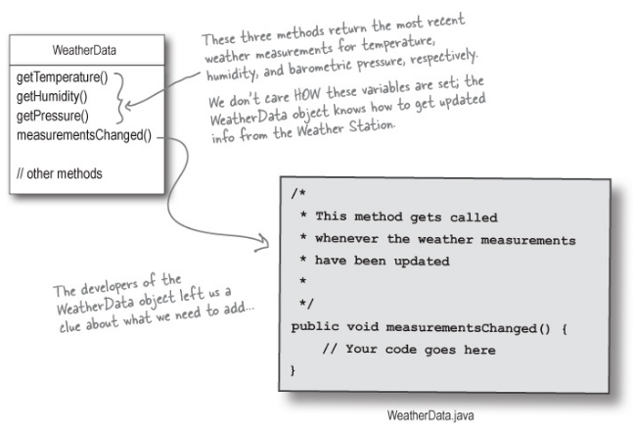

Slide 6
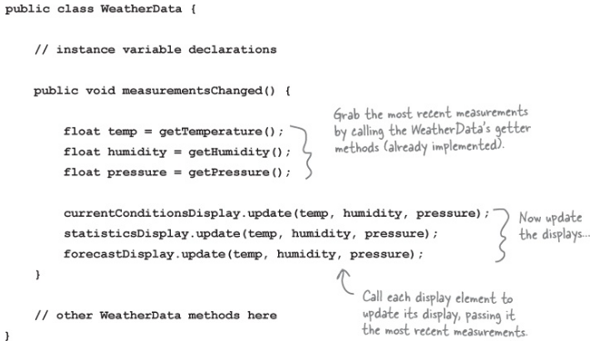

Slide 7
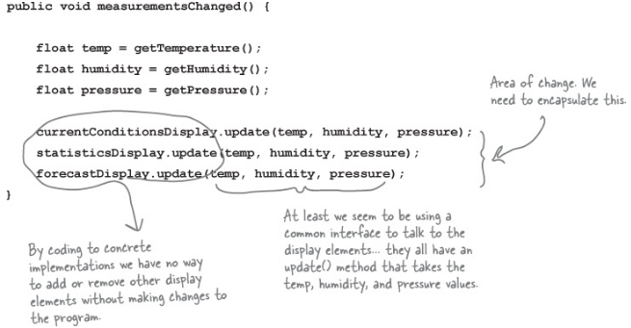
Whats wrong

Slide 8
We are coding to concrete implementations, not interfaces.
For every new display element we need to alter code.
We have no way to add display elements at run time.
We haven’t encapsulated what changes.

Slide 9
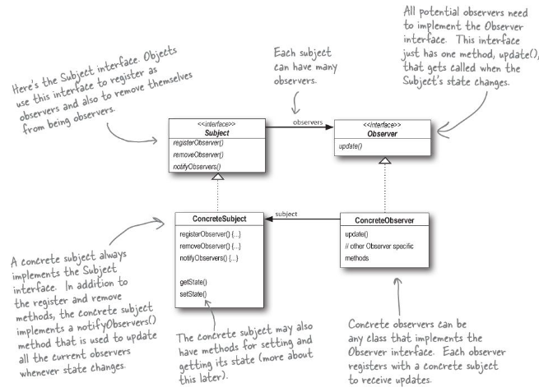

Slide 10
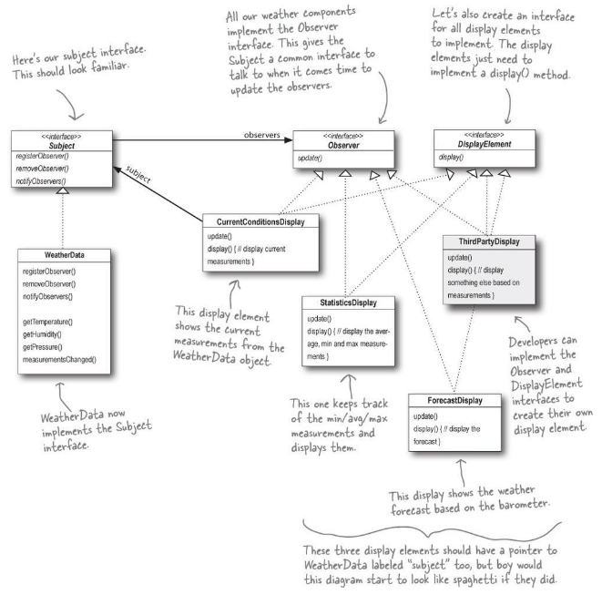

Slide 11
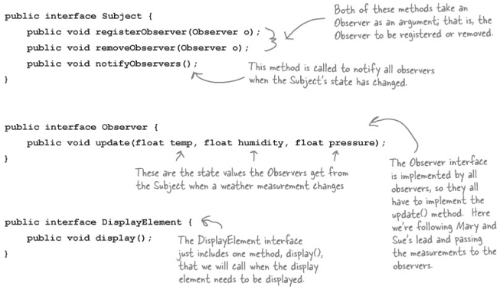

Slide 12
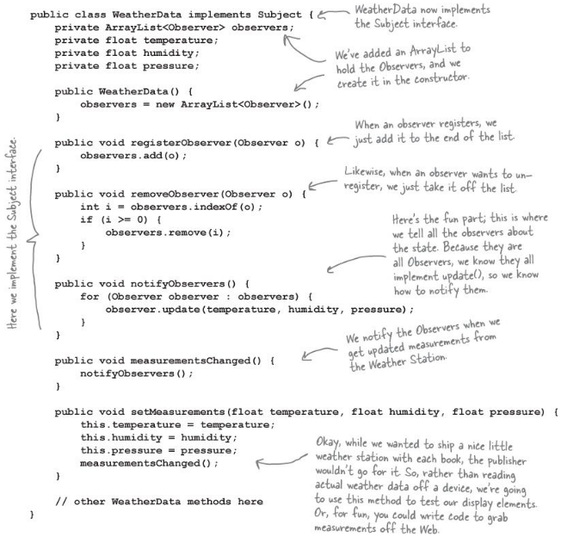

Slide 13
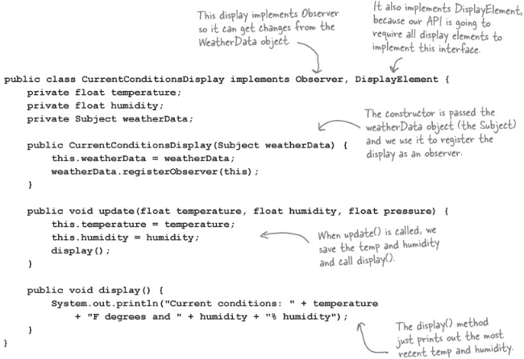

Slide 14
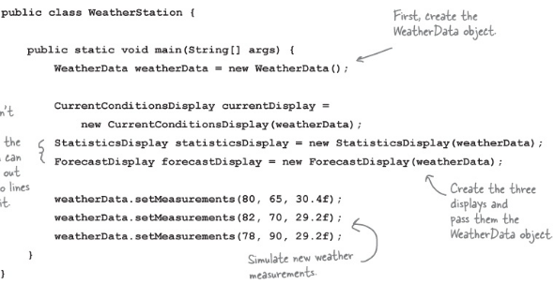

Slide 15
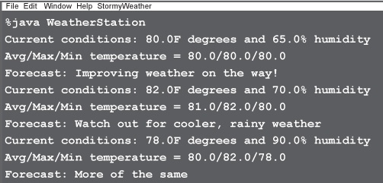

Slide 16
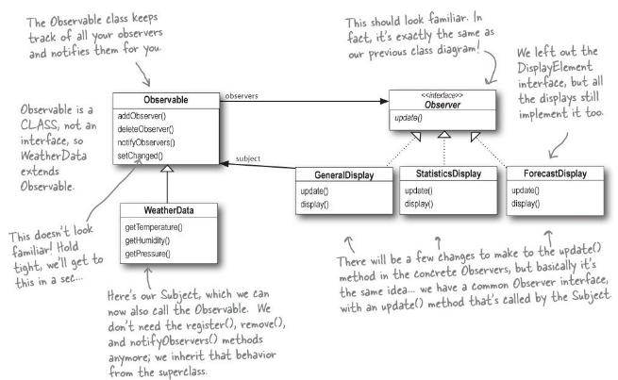

Slide 17
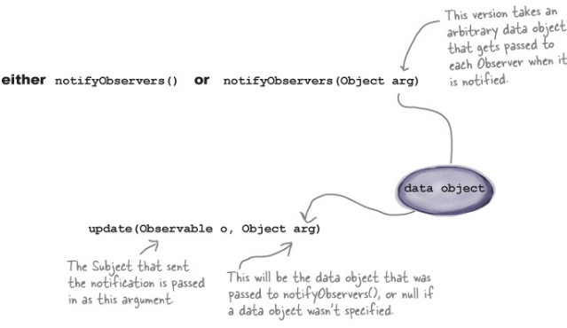

Slide 18
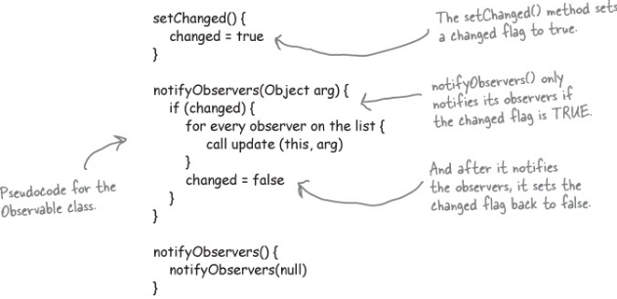

Slide 19
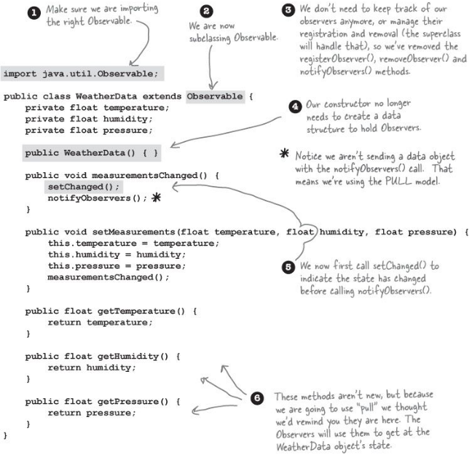

Slide 20
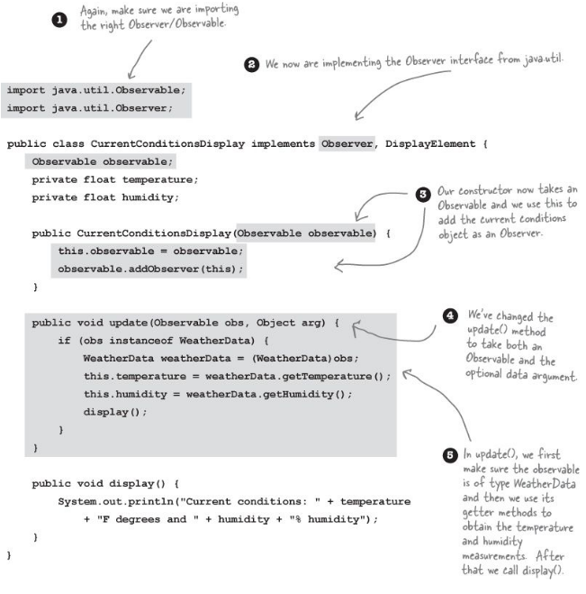

Slide 21
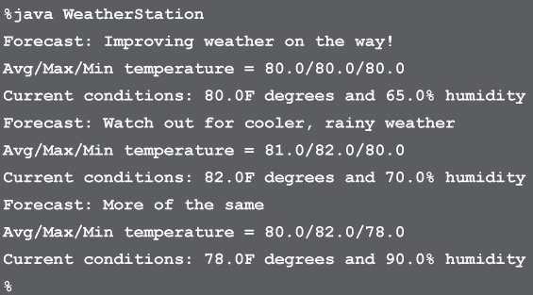

Slide 22
Strive for loosely coupled designs between objects that interact.
The Observer Pattern defines a one-to-many dependency between objects so that when one object changes state, all of its dependents are notified and updated automatically.

Slide 23
Observer Pattern

Slide 24
Questions??

Slide 25
Questions

